Slide 1
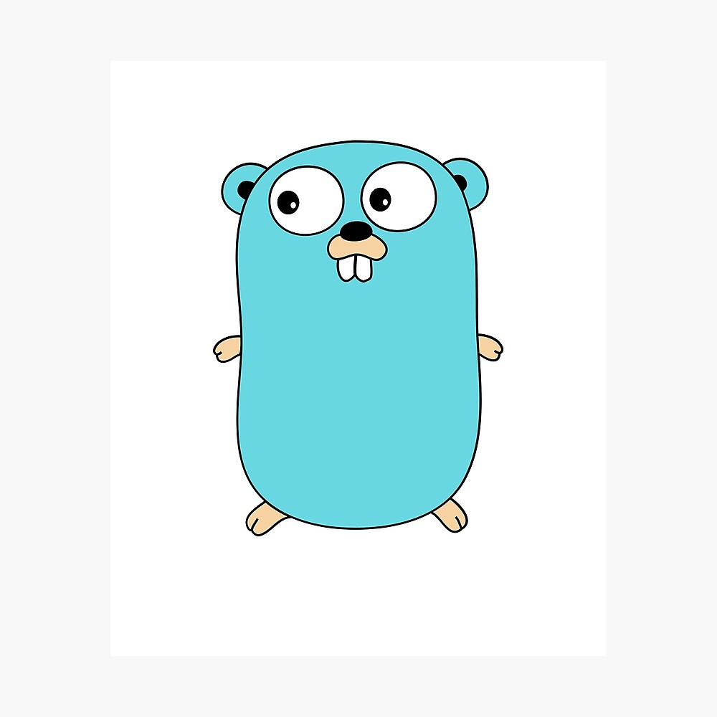
Interface

Slide 2
Interface
type programmingLanguage interface {
showName() string
showCreator() string
}

Slide 3
Membuat struct
type data struct {
name string
creator string
}

Slide 4
Function Interface
func (d data) showName() string {
return d.name
}
func (d data) showCreator() string {
return d.creator
}

Slide 5
Pemanggil method
func showInfo(pl programmingLanguage) {
fmt.Println(pl)
fmt.Println(pl.showName())
fmt.Println(pl.showCreator())
}

Slide 6
Main Function
func main() {
data := data{
name: "PHP",
creator: "Rasmus Leedorf",
}
showInfo(data)
}

Slide 7
Thank you
andrewmanuelt@gmail.com

